Slide 1

Notes:
INSTRUCTOR NOTE: This module should be presented by a knowledgeable, experienced and trained instructor with experience in grain handling and storage, as well as the OSHA grain handling standard.
This module & the accompanying video are based on FEDERAL OSHA regulations. States governed by OSHA approved state plans have OSHA-approved job safety and health programs operated by individual states instead of federal OSHA. Some of their regulations may differ. It is up to the instructor to inform participants of the differences or to warn participants some regulations may differ and they should check with their state regulations.
INSTRUCTOR MANUAL –
The Powerpoint® notes pages are the instruction manual for this module. The note pages have been formatted to help guide the instructor through key points and discussion points for each slide.
Discussion points and audience participation questions are contained in the body of the notes pages. These are intended as talking points to either further explain the slide contents or engage the audience. Modules are designed for 90 - 120 minute sessions.

Slide 2
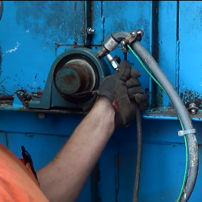
Mantenimiento Preventivo
ELEVADORES DE CANGILONES
Notes:
Introduce Preventive Maintenance for Bucket Elevators
Ensure attendance sheets are correctly filled out and signed.
Administer pre-tests..

Slide 3
Introducción
Este módulo de Mantenimiento Preventivo para Elevadores de Cangilones es parte de un programa educativo sobre los peligros encontrados en las áreas de manejo de granos incluyendo los compartimientos de grano y sus alrededores. Su propósito es ayudar a los participantes a identificar y disminuir los peligros en el lugar de trabajo.
Notes:
Explain this module is part of a series.
Other modules
Overview of Grain Handling & Storage Safety (introductory module)
Lock out/Tag Out: Each time, Every Time – mini module
Entanglement Hazards and Guarding
Fall Hazards and Prevention
Grain Bin Entry Hazards
Introduction to Lifeline Protection Systems
Agricultural Confined Space Hazards
Reducing Grain Bin Entry Risks
Flat Storage and Ground Piles
Hot Work

Slide 4
Descargo de Responsabilidad
Este material fue producido bajo el número de concesión SH-27664-SH5 de la administración de seguridad y salud ocupacional, Departamento de trabajo de los Estados Unidos. No necesariamente refleja las opiniones o políticas del Departamento de trabajo de los Estados Unidos, ni la mención de nombres de oficios, productos comerciales u organizaciones implican el aval del gobierno de los Estados Unidos.
Notes:
Explain – GHSC received funding from OSHA. In order to comply with the grant we do need them to sign in and need to collect the following information:
Supervisor or worker. This information is for statistical purposes to show the types of population receiving training.
Employer. This is to establish an employer/employee relationship as covered under OSHA. Volunteer rescue workers who may be attending should list their employer; not the volunteer rescue squad. Farmers should list the registered business name of their farm. Farm employees should provide the business name listed on their paycheck.
OSHA does NOT contact the employer.
GHSC may contact the attendee or employer for follow-up evaluation in compliance with grant requirements.

Slide 5
Derechos de los Empleados
Los empleados tienen derecho a condiciones de trabajo seguras y saludables que NO representen riesgo de algún daño severo.
Los trabajadores tienen derecho a un salario justo por las horas trabajadas de acuerdo con la ley.
Notes:
Explain - All DOL grants require that employees are informed of their rights. In this instance we want to emphasize employees are entitled to a safe and healthy working environment AND to fair receive compensation for their work.
Remind employees – it is the employee’s responsibility to follow the safety practices, policies, and procedures of their employers.
Tell participants their rights also include the right to report unsafe conditions to the OSHA hotline without retribution.
More information about employee rights can be found on the OSHA website: www.osha.gov or the Department of Labor website www.dol.gov .
It is ESPECIALLY imperative for youth/young workers to access information and know their rights, what to expect, and how to get help if needed.

Slide 6
Responsabilidad del Empleador
Los empleadores tienen la responsabilidad de proveer un lugar de trabajo seguro y saludable.
Encontrará mas información sobre los derechos del empleador y los empleados en la pagina web ww.osha.gov.
Notes:
Explain employers have a legal responsibility to provide a safe workplace. This means they must ensure the regulations which govern their business are instituted and followed. This applies to 1 employee or more.
Discuss - It is the employers’ responsibility to know the rules and laws – federal and state.
Emphasize – It is employers’ responsibility to ensure employees, know, understand and follow regulations and company policies.
Stress - If employers are unsure of the regulations they should consult with the appropriate agency. Every state has an on-site consultation program jointly funded by OSHA and the state which provides assistance in learning and complying to the regulations.
The OSHA website provides contact information for each state’s on-site consultation program.
Illinois Department of Labor has the on-site consultation program in Illinois.
Employers should also know and understand the state’s laws as they may be more restrictive than OSHA. Contact the state department of labor.

Slide 7
Objetivos de Aprendizaje
Al finalizar este módulo, los participantes serán capaces de:
Entender procedimientos básicos de mantenimiento preventivo para elevadores de cangilones
Identificar componentes que requieren inspección o mantenimiento
Notes:
Introduce the learning objectives. These are the knowledge the participant should acquire as well as tasks or skills they should learn to perform.
Explain – the module was designed to seek interaction from the participants. Questions will be asked throughout to generate discussion.
Encourage – the sharing of ideas, information, experiences so everyone can learn.

Slide 8
Preparar y Realizar Mantenimiento Preventivo
Notes:
Prepare for preventive maintenance.

Slide 9
Mantenimiento Preventivo
A tiempo y Correctamente
Evita las fuentes de ignición
Protege
  Trabajadores
  Producto
  Equipo
A menudo se pasa por alto – algo va mal
  Menos precaución
Notes:
Legs are the work horses of the grain elevator – carrying and moving hundreds of thousands or millions of bushels of product each year.
Being in good working condition is essential to efficient, productive, and profitable operations.
Scheduled, preventive maintenance is often overlooked or put aside until something goes wrong.
Unscheduled work stoppage – in any industry – leads to a more hurried, less cautious approach putting workers at risk of forgetting or bypassing safety measures.
Preventive maintenance of bucket elevator legs is crucial to controlling ignition sources. Most fires and/or explosions at grain storage facilities occur when some component of the conveying system becomes overheated due to friction.
As on-site storage gets larger it will become more critical for farms to use the same precautions and safety measures as the commercial industry.
Using a scheduled maintenance plan, reduces work stoppages, protects workers, can aid in better storage quality of the product and protects the equipment from unnecessary and often destructive wear/tear.

Slide 10
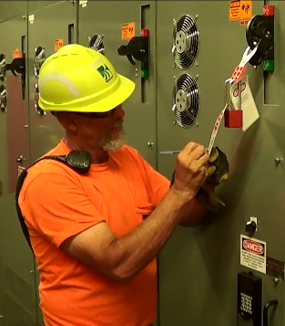
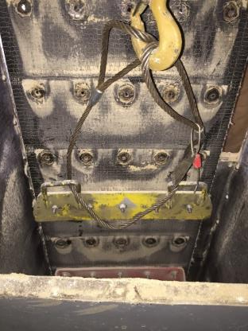
Candado/Etiqueta Antes de Trabajar
Sujetar/asegurar banda
Motor de accionamiento a transportador
Notes:
Prior to working on energized Bucket Elevator where contact with the belt, buckets, rotating parts, or electricity is possible:
Lockout/tagout the drive motor to the conveyor.
Prior to splitting a belt or working on a belt that could spin due to gravity**: Clamp or otherwise secure the belt from spinning.
This is usually for major maintenance and not something you would need to do for a regular inspection. If gravity can be a hazard – then secure the belt.

Slide 11
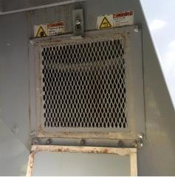

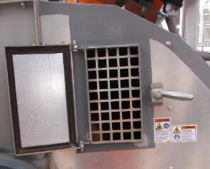
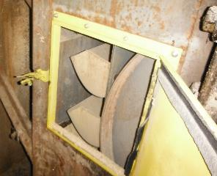
Etiquetar y Resguardar Puertas de Inspección
Etiquetas de advertencia
Malla de resguardo - Detrás
  Abrir sin herramienta
Resguardo
Resguardo
Sin resguardo
Notes:
Verify warning labels are on all inspection doors.
Verify Inspection doors with wing nuts, spring clamps, etc.…that don’t require tools to open have guard mesh behind them.
Sign photo: Design ©Clarion Safety Systems. All rights reserved. www.clarionsafety.com. (written permission)

Slide 12
Inspeccion de Banda y Cangilones
Notes:
This section discusses the inspection of the buckets and belts

Slide 13
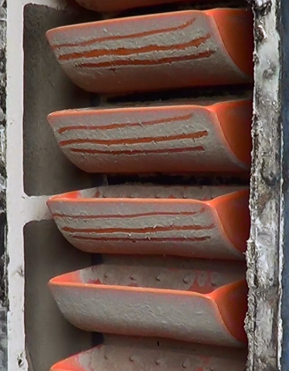
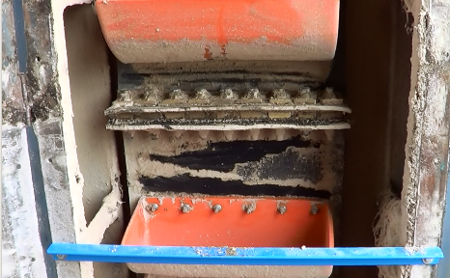
Observar Una Vuelta Completa
Comenzar en el empalme o marca
Comenzar en empalme
Marca de inicio
Notes:
Observe the belt and buckets through a complete loop.
Start at the splice or another “mark” so you know you have inspected all.

Slide 14
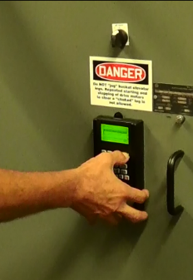
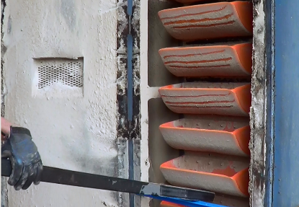
Rotar la Banda Lentamente
Manualmente
Variador de velocidad
Accionamiento de arrastre
Manual – usar barra
Ajustar el Variador de velocidad
Notes:
Move with variable speed drive if equipped (should be guarded), or
Move with a creep drive if equipped

Slide 15
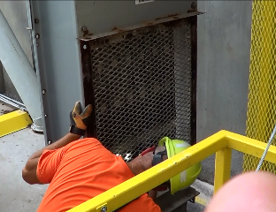
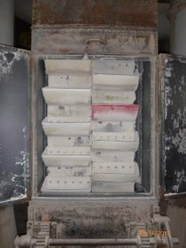
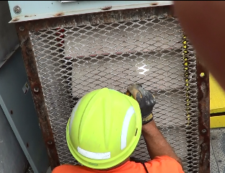
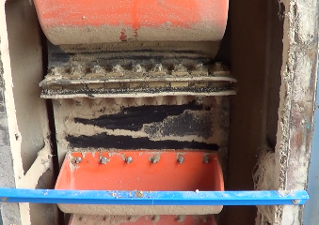
Mirar Delante/Detrás por Desgaste y Desgarro
Puerta resguardada –variador de velocidad
Vista de la Banda – Puerta Abierta
Notes:
Belt Inspection
Look at front of belt
Look at back of belt
Inspect for wear
Inspect for tears

Slide 16
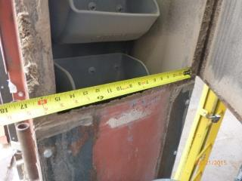
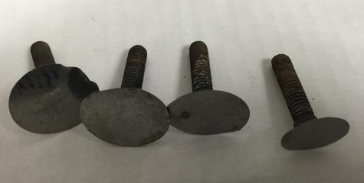
Banda Centrada en la Carcasa
Centrada en la carcasa
Grietas, roce
Separación, burbujeo
Pernos faltantes, desgastados, sueltos
Comprobar alineamiento
Comienza desgaste
Bordes afilados
Notes:
Belt Inspection
Inspect for severe cracks, rubbing, separation, and bubbling
Look for missing, worn, or loose bolts
Check for centering of the belt in the casing. Out of align increases wear & friction

Slide 17
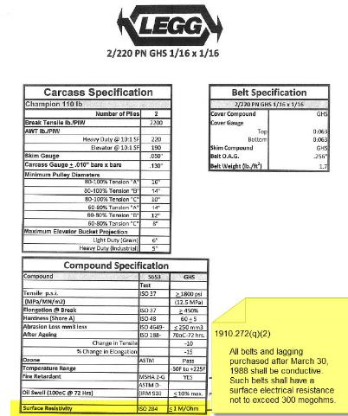
El Material de la Banda es Conductivo
Verificar que el material de la banda sea conductivo
Resistencia eléctrica superficial ≤ 300 megohms
Notes:
Belt Inspection
Verify belt is of the correct material
1910.272(q)(2)
All belts and lagging purchased after March 30, 1988 shall be conductive. Such belts shall have a surface electrical resistance not to exceed 300 megohms.

Slide 18
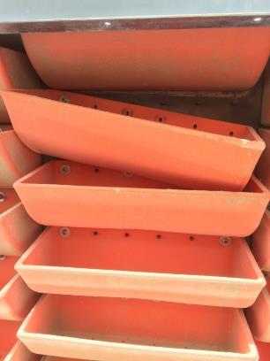
Inspeccionar los Cangilones por Desgaste Inusual
Inspeccionar
  Pernos y tuercas faltantes/sueltos
  Cangilones agrietados, quebrados, sueltos
  Patrones y nivel de desgaste
Investigar desgaste inusual
  Indicar punto de desgaste en la carcasa
Tuercas faltantes y Cangilones sueltos
Notes:
Buckets showing unusual wear indicate other problems. Investigate thoroughly to ensure the wear is not creating friction – a potential ignition source.

Slide 19
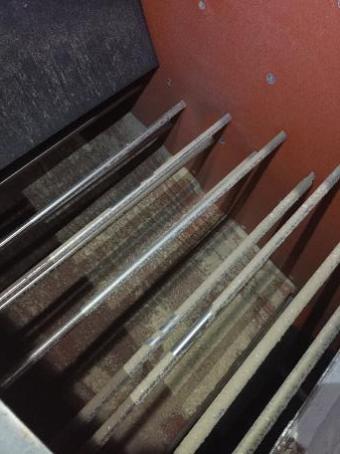
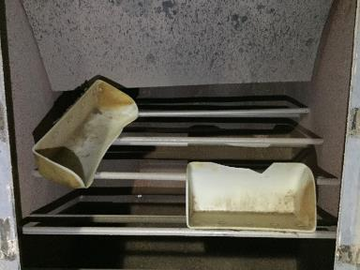
Cangilones Faltantes
Que no bloqueen boca de descarga
Revisar cangilón colector en boca de descarga
Barras del cangilón colector en la descarga
Cangilón atrapado en barras
Notes:
Bucket Inspection - If missing buckets verify they are not blocking discharge spout.
Check bucket catcher on discharge spout if equipped.

Slide 20
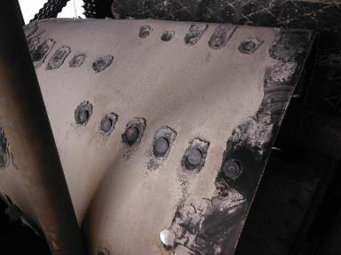
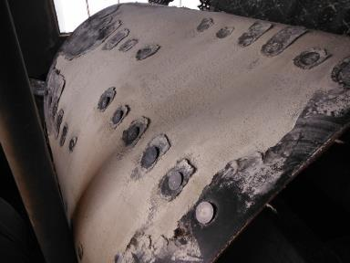
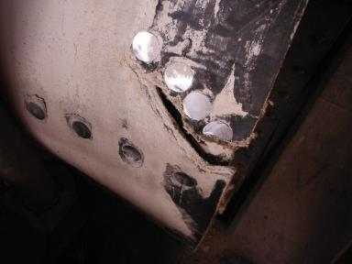
Vistas del Desgarro en la Banda
Notes:
These pictures show different views of a belt tear which needs to be repaired. The torn belt can create other problems in the conveying system.

Slide 21
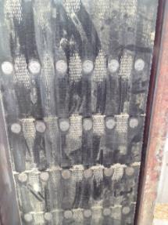
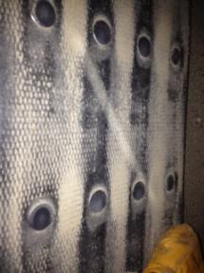
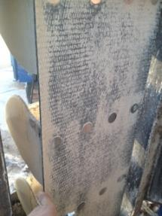
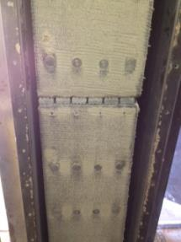
Deterioro de la Banda PVC
Notes:
These pictures show deterioration of the pvc belt. This can create other maintenance issues.

Slide 22
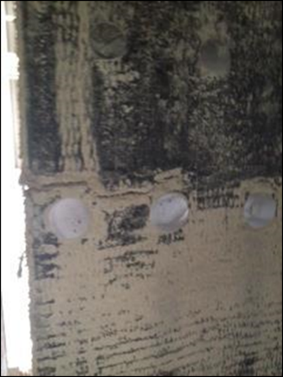
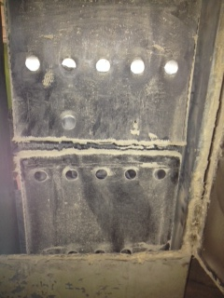
Ejemplos de Desgaste en la Parte Posterior
Notes:
Both the front and back of the belt needs to be instpected for wear and tears.

Slide 23
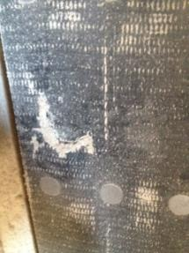
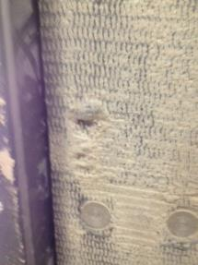
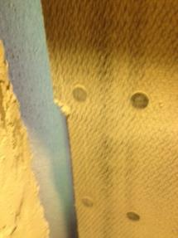
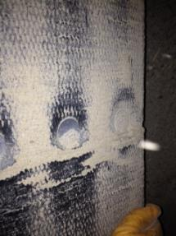
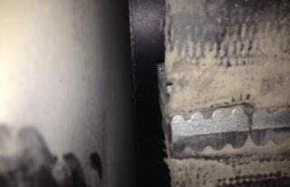
Desgaste en Parte Posterior de las Bandas
Notes:
These pictures show several examples of the different types of wear and tears the backside of the belt can develop.

Slide 24
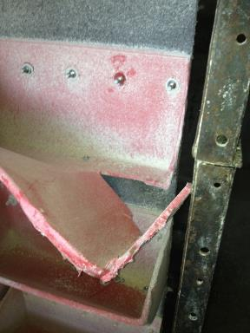
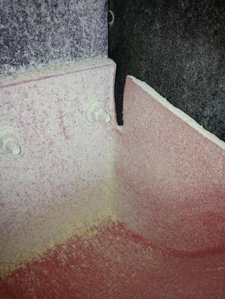
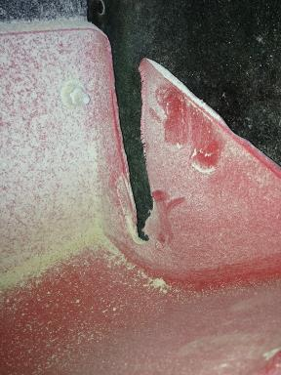
Cangilones Agrietados/Quebrados
Notes:
Look for broken, cracked, buckets and buckets missing bolts, etc. These can break off and become lodged keeping the system from operating smoothly.

Slide 25
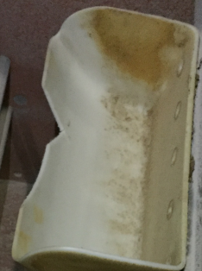
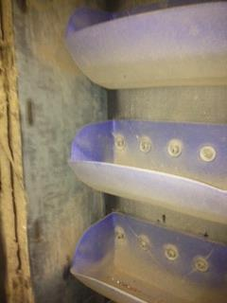
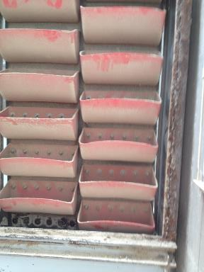
Problemas Encontrados en Inspección
Grieta
Cangilón faltante
Notes:
Buckets that are cracked, missing bolts, broken, etc. need to be replaced.

Slide 26
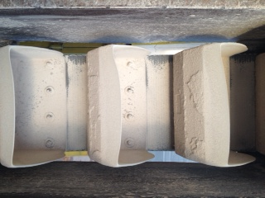
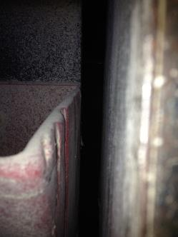
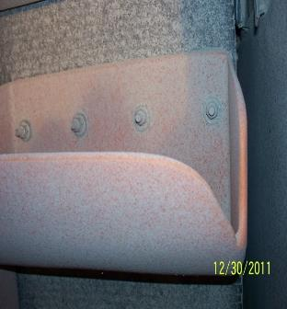
Signos de Desgaste - Fricción
Notes:
These show wear patterns indicating friction is occuring. Friction is a potential ignition sources as it creates heat.

Slide 27
Empalmes de Banda
Notes:
This section talks about proper belt splices.

Slide 28
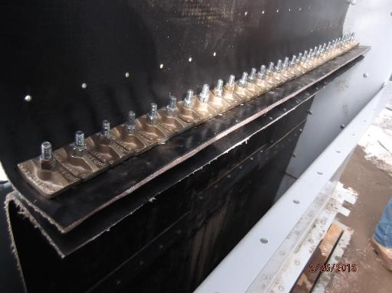
3 Tipos de Empalmes de Banda
Empalme Mecánico
Superpuesto
A tope
Mecánico
Notes:
There are three types of belt splices – lap, butt, and mechanical.

Slide 29
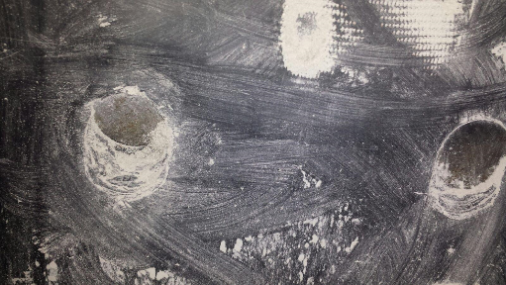
Empalme Superpuesto y de Tope
Apretar las tuercas
Verificar la condición de los pernos
Revisar la condición de la banda
Pernos tiran a través del empalme de banda
Notes:
Lap and butt Splice
Torque the Nuts to manufacturer’s specifications
Verify bolt condition
Review belt condition as discussed earlier

Slide 30
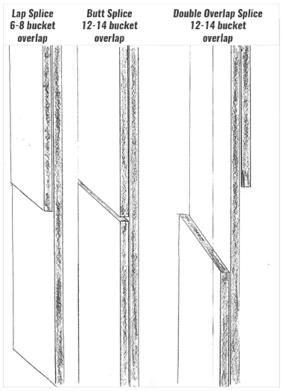
Garantizar la superposición de empalmes
Superposición del cangilón
Superpuesto ≥ 6-8
A tope ≥ 12-14
Superpuesto doble ≥ 12-14
Lado de polea
Lado de polea
Lado de polea
Notes:
There should be at least 6-8 buckets worth of overlap on lap splices.
12-14 buckets worth of overlap on Butt or Double Lap.

Slide 31


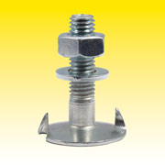
Tuercas y Pernos del Empalme
Mejor – Tuerca de brida grande, sin arandela extra
Tuerca doble – brida dentada y arandela de guardafangos
Evite las tuercas de brida pequeñas y la arandela de guardafangos separada
Notes:
Large flange nuts with no extra washer are the preferred connector.
Small flange nuts with separate fender washers have a history of working loose.
If you have serrated flange nuts and fender washers on your splice make sure to double nut them.

Slide 32
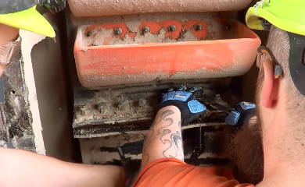
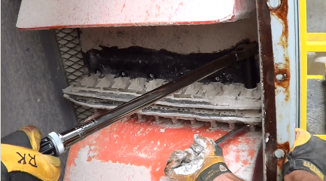
Inspección de Empalme Mecánico
Apretar tuercas
Inspeccionar piezas metálicas
El material de la banda en la curva
  Verificar ‘AB’ no-ferroso
Comprobar apretado de tuercas
Notes:
Mechanical Splice
Torque the Nuts to manufacturer’s specifications.
Inspect the condition of metal pieces.
Inspect the belt material at the bend of the splice.
Verify “AB” Non-ferrous.

Slide 33
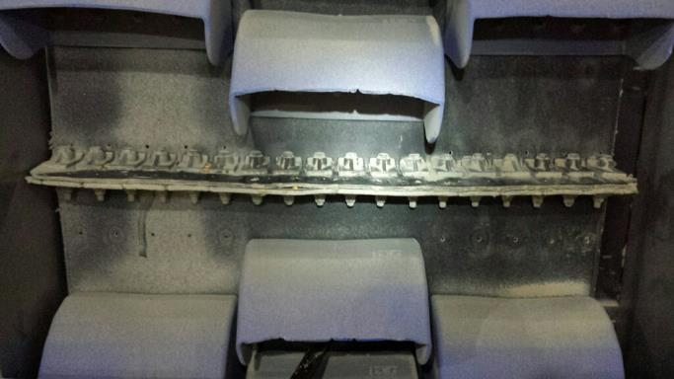
Utilice Plantilla para el Espaciado de la Abrazadera
Utilice plantilla
Siga las especificaciones del fabricante
Empalme ferroso mal instalado. Espacio de abrazadera muy separado
Notes:
Picture of ferrous splice not installed correctly.
Spacing of clamps is too far apart.
Follow manufacturer specification and use template.
On picture - Should Have Used The Template That Comes From Manufacturer of The Splice. Wrong Spec. of Material.

Slide 34



Empalmes Desgarrados
Empalme mecánico desgarrado
Empalme superpuesto desgarrado
Empalme superpueso desgarrado
Notes:
These are examples of torn splices. These need to be appropriatly fixed to avoid further wear and friction.

Slide 35
Inspeccion de Polea
Notes:
This section discusses the knee pulley.

Slide 36

Polea – Inspeccionar Todas las Partes
Rodamientos
Polea
Conducto y sensores de rodamiento
Resguardo
Polea completamente resguardada
Notes:
Verify guarding is complete and secure
Check conduit and bearing sensors

Slide 37

Rodamiento de Polea:
Mirar, Escuchar
Inspeccionar visualmente
  Infrarrojo
Escuchar mientras funciona
Lubricar
  La grasa va a
  salir
Notes:
While running listen to the bearing.
Visually inspect bearing. Use infrared if available to check bearing
Lubricate bearings until grease begins to purge from the bearings

Slide 38


Polea – Apretar Partes del Rodamiento
Revisar Anillo de Bloqueo
Apretar el soporte
(Usar llave ajustable)
Notes:
Check bearing lock collar bolts for tightness.
Tighten bearing mounts. It is better to use a fitted wrench.

Slide 39



Inspección de Polea
Revisar pernos del casquillo
El recinto de la polea está abierto para inspección
Revisar cara de polea
Buscar desgaste, grietas, etc
Notes:
Inspect the pulley for general condition (wear, cracks, etc.).
Verify bolt tightness on bushings

Slide 40

Polea Dañada
Notes:
This damaged knee pulley can create additional problems.

Slide 41



Sensores de Bloqueo por Roce Deben Hacer Contacto
Colocación – banda/polea hace contacto con sensor de bloqueo
  Revisar el cableado
Puerta de inspección
Soporte colgando
Captura el movimiento de la polea, banda
Notes:
Inspect for placement to make sure the belt and/or pulley will contact the rub block
Inspect wiring
Inspect for wear
Wear dead center is the worst
Replace if worn more than ½ through or if worn at center
Replace if worn to where it doesn’t protect side casing

Slide 42

Sensor de Bloqueo por Roce- Desgaste en el Centro es lo Peor
Desgaste – en el centro es lo peor
Reemplazar
  Desgaste > ½ a través o en el centro
  No protege la carcasa lateral
Bloqueo necesita reemplazo
Notes:
Inspect for placement to make sure the belt and/or pulley will contact the rub block
Inspect wiring
Inspect for wear
Wear dead center is the worst
Replace if worn more than ½ through or if worn at center
Replace if worn to where it doesn’t protect side casing

Slide 43

¿Podrá este Sensor de Roce Capturar un Roce Posterior?
Vieja marca de roce
Notes:
,The red line indicates the wear pattern. The sensors may not capture all points where rubs are occurring which is why visual inspection needs to occur on a scheduled basis.

Slide 44


Pruebe el Sensor de Bloqueo
Pruebe el sensor - utilice el probador del fabricante
Alternativa - aerosol congelante
  Lectura del monitor muestra descenso en temperatura
Aerosol en sensor
Observar cambio en monitor
Notes:
Test sensor
Use manufacturer’s tester if they have one
Another method is to spray with freeze spray
Verify temperature monitor readout shows a drop in temperature

Slide 45


Inspeccione Carcasa por Alineamiento
Puntos de desgaste; signos de roce
  Utilice infrarrojo
Señales de colocación/falta de alineamiento
Carcasa
oxidada
y
soportes
débiles
Usando infrarrojo para buscar roces
Notes:
Inspect for wear points
Inspect for signs of rubbing
Infrared is a great tool
Inspect for signs of settling/out of alignment issues

Slide 46
Respiraderos de Explosion
Notes:
This section discusses explosion vents.
Explosion vents are a critical safety feature.

Slide 47


Respiraderos de Explosión Instalados Correctamente
Remover pernos de transporte
Pernos y arandelas correctas
No bloqueado del escape
Etiquetas de advertencia
Cables/correas de seguridad
Pernos faltantes
Respiradero de explosión superior
Notes:
Inspect for general condition
Inspect to make sure shipping bolts removed
Inspect to make sure correct bolts and washers in place
Verify it is not blocked from being released
Verify they have warning labels
Verify any safety catch cables or straps are in place
LEFT PICTURE – EXPLOSION VENT AT THE TOP OF THE LEG
RIGHT PICTURE– MISSING EXPLOSION VENT BOLTS

Slide 48


Pernos de Transporte
Debe remover pernos de transporte antes de ponerlo en servicio.
Pernos de transporte
no removidos
Faltan etiquetas
Etiquetas de advertencia para remover pernos de transporte
Notes:
Explosion vents are bolted closed for shipment.
Before the explosion vent is placed into service these shipping bolts need to be removed.
Labels are attached to the shipping bolts to identify them, but they may break off or get damaged during shipping. Carefully check to ensure all the shipping bolts are removed.
The vent operates by “blowing” off if the pressure inside is to great – preventing a more catastrophic explosion. If the bolts are not removed the vent cannot function properly.

