Slide 1

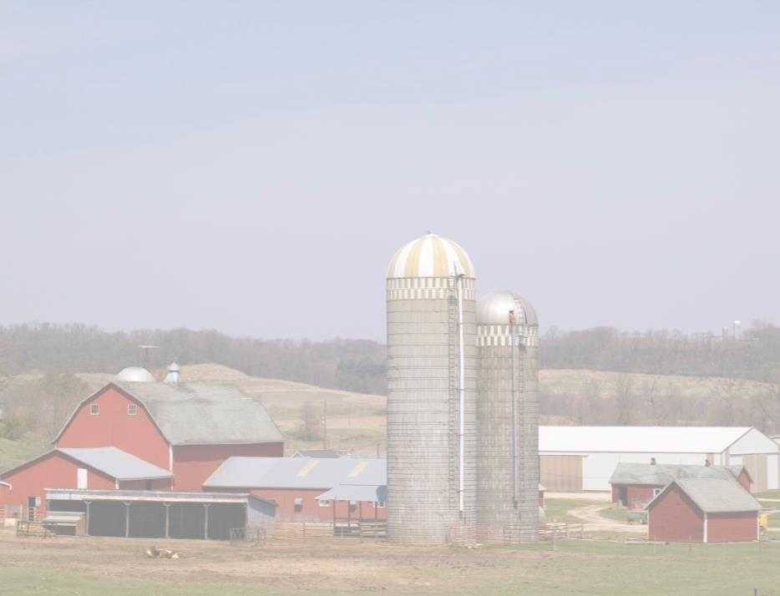
Skid Steer Safety for Youth
This material was produced under a grant (SH-27642-SH6) from the Occupational Safety and Health Administration, U.S. Department of Labor. It does not necessarily reflect the views or policies of the U.S. Department of Labor, nor does the mention of trade names, commercial products, or organization imply endorsement by the U.S. Government.
The National Education Center for Agricultural Safety (NECAS) 888-844-6322

Slide 2
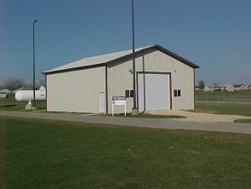
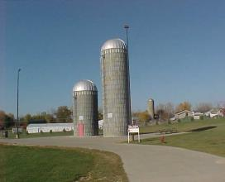
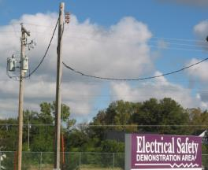
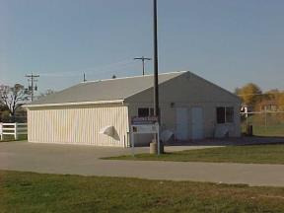
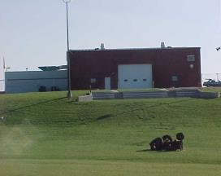
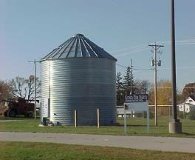
Hands-on Training Sites
Farm chemical site
Silo training props
Electrical Safety
Confinement building
Tractor rollover
Grain Bin prop
Notes:
Pictures from NECAS

Slide 3
Program Objectives
At the conclusion of this presentation, participants will:
  Be able to identify hazards associated with Skid Steer use in Agriculture
  Know where to look for OSHA references and resources related to Skid Steer use in Agriculture
  Be able to do a pre-trip inspection on your Skid Steer
  To safely perform maintenance on your Skid Steer

Slide 4
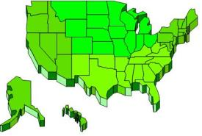
Statistics:
Involvement in Farming in the U.S.
2.1 Million farmers
2% of the population
Reference: http://www.epa.gov/oecaagct/ag101/demographics.html
Notes:
5
Here in the US it include about 2% of the population and we are seeing a shift from the family farm to larger production units.
The spouse is working off the farm to bring revenue and insurance back to the farm.
Reference: http://www.epa.gov/oecaagct/ag101/demographics.html

Slide 5
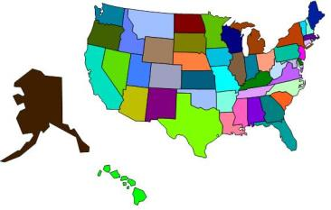
Statistics of Injury/Mortality:
U.S.
570 Fatalities (2015)
22.8 deaths per 100,000 workers
Notes:
7
This data is nationwide for Agriculture
22.8 deaths per 100,000 workers for Agriculture
2015 CFOI-BLS

Slide 6
Safety Procedures
Always wear your seatbelt and use restraint bar
Use 3 point method of entry and exiting the skid loader
Lower bucket to park safely
Lower bucket to enter and exit safely
NO extra riders
Notes:
Top Ten Suggestion for Skid Steers (Penn State Extension)

Slide 7
Pre-trip inspection
Outside
Lights
Flashing warning lights
Steps and handrails
Tires and/or tracks
Bucket and/or attachments
Lifting Mechanism
Hoses
Fittings Greased

Slide 8
Pre-trip inspection (continued)
Inside
Brakes
Backup alarm
Fire extinguisher
Gauges
Horn
Hydraulic Controls
Glass
Mirrors
Seat belt and seat
Steering controls

Slide 9
Pre-trip inspection (Slide 3)
Fluids
Visible leaks
Coolant levels
Hydraulic oil levels
Transmission fluid
Fuel levels
Engine
Battery and cables
Belts
Hoses
Air filter
Guards

Slide 10
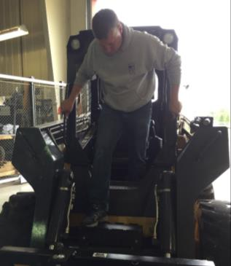
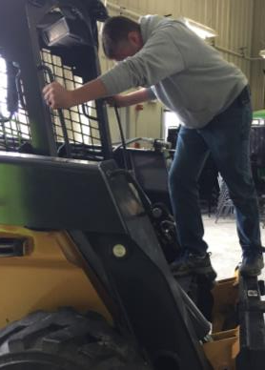
Entry and Exit into the Cab
Use the three points of contact Rule
Make sure bucket or attachment is in the lowered position before entering or exiting the machine.

Slide 11
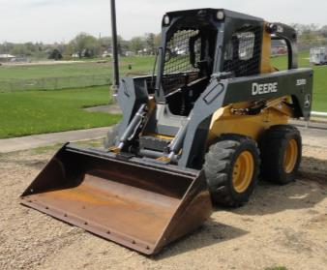
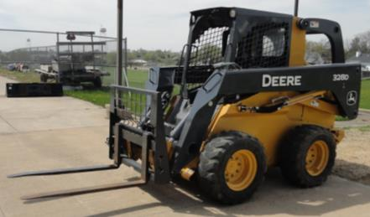

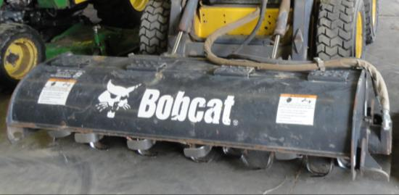
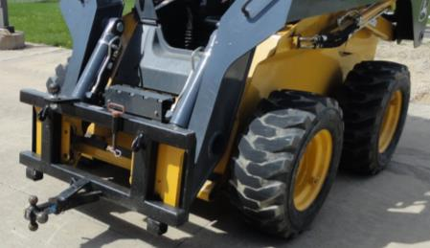
Attachments
Notes:
Pictures from NECAS
Top row left to right: Bucket, Manure Pusher, Forklifts
Bottom: Cultivator, Trailer mover

Slide 12
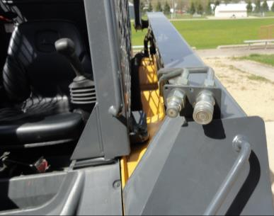
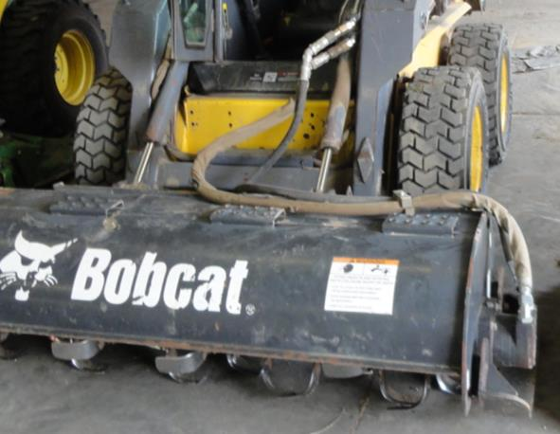
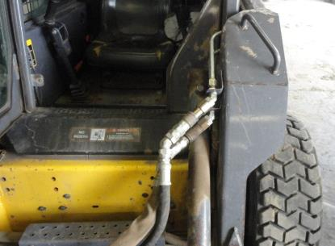
Hydraulics
Notes:
Pictures from NECAS. Hydraulic lines that have been damaged can be very dangerous. Never look for a pin hole leak with your hands. Hydraulic fluid can be injected into you skin at a high pounds per square inch (PSI) causing bodily damage.

Slide 13
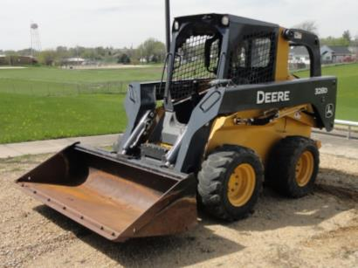
When traveling
Always keep the bucket low and if your field of vision is blocked, travel backwards
Notes:
Pictures from NECAS

Slide 14
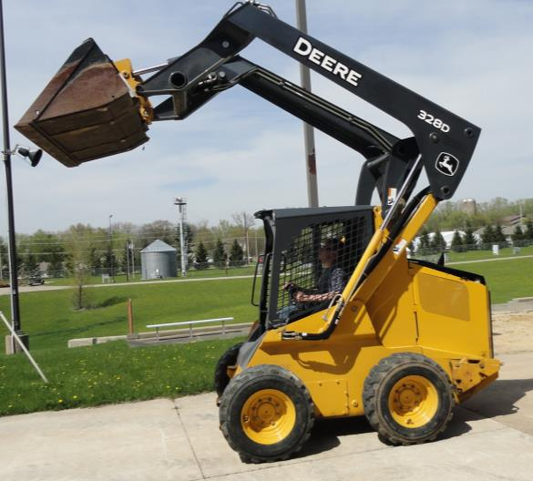
Center of Gravity
Notes:
Pictures from NECAS
The center of gravity for a skid steer constantly shifts depending on the job and attachment. Typically, the weight of the skid steer is concentrated at the rear of the machine between the wheels. However, weight at the front of the skid steer, as when moving items with a bucket or an attachment, shifts the center of gravity forward and higher.
Skid Steer Safety. (2012) Farm and Ranch eXtension in Safety and Health (FReSH) Community of Practice. Retrieved from http://www.extension.org/pages/64425/skid-steer-safety.

Slide 15
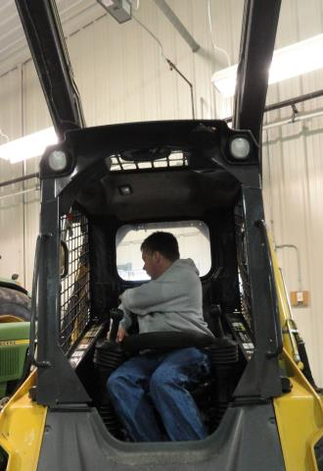
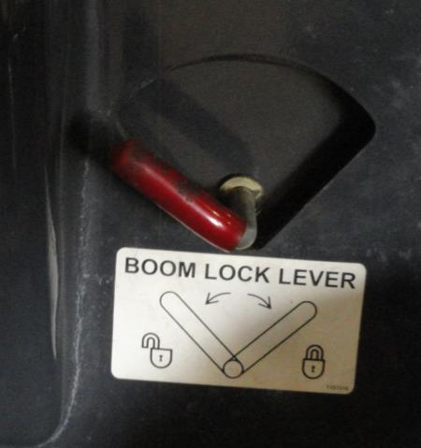
Locking the Bucket in the air for service
Notes:
Pictures from NECAS. When needing to service the machine with the bucket in the air be sure to lock the bucket in an upright position. A Hydraulic leak can cause a catastrophic collapse or a slow leak in which the arm of the bucket can slowly lower onto a victim who maybe working on the machine causing injury or death

Slide 16
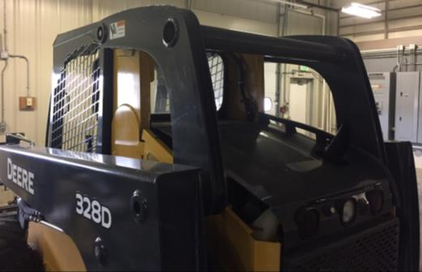
ROPS
Roll Over Protection Structure
Protects the operator in the event of a rollover
Notes:
Photo Courtesy of NECAS
Skid Steer Safety. (2012) Farm and Ranch eXtension in Safety and Health (FReSH) Community of Practice. Retrieved from http://www.extension.org/pages/64425/skid-steer-safety.

Slide 17
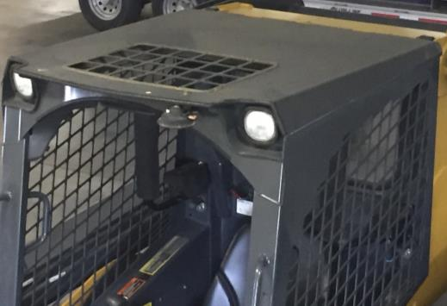
FOPS
Falling Object Protective Structure
Protects the operator from objects that fall on top of the cab
Notes:
Photo Courtesy of NECAS
Skid Steer Safety. (2012) Farm and Ranch eXtension in Safety and Health (FReSH) Community of Practice. Retrieved from http://www.extension.org/pages/64425/skid-steer-safety.

Slide 18
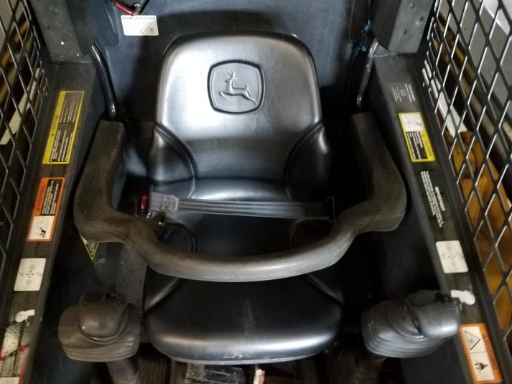
Seat Belt and Restraint Bar
Notes:
Photo courtesy of NECAS
Never modify, bypass, disable, or override safety systems. Similarly, never operate equipment in which safety systems have been modified or are not working properly. Equipment with modified or malfunctioning safety systems should be taken out of service until repaired or replaced. Information from: SHIB 01-12-2009

Slide 19
Be Alert
Limited Visibility from Operators station
Be alert for Co-Workers and Children
Notes:
Visibility to the side and rear of the skid steer is limited and you may not e able to see humans or structures to the side or rear. Caution must be used.

Slide 20
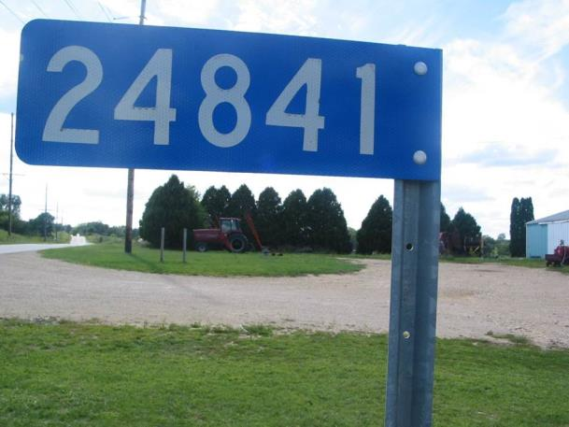
Know your Location
Notes:
A lot of farms today not only include the home farm but rental properties or purchased farms not located adjunct to the home farm. It is important to know the physical address and 911 address of the location. It is recommended that you write down each farm, its 911 address, physical address, and who owned it before. This information should be carried in every moving vehicle that goes from farm to farm. The GPS on your phone can track you in an emergency but that takes time and in an emergency that time could be essential.

Slide 21

Calling 911
Name:
Address or 911 number
Exact nature of the emergency
Do not hang up
Notes:
Instructor Notes:
When a call for emergency services is made, usually to 911, the dispatcher needs several important pieces of information to ensure that assistance is provided in a timely manner. It is extremely important that the caller stay on the line until the dispatcher is adequately informed. In some cases, 911 calls are made and the caller hangs up before an address is provided or the nature of the emergency is explained. In some communities, the 911 dispatcher knows the address and the callers identification. However, the caller’s home address may not be the site where the assistance is needed.
In most cases the 911 dispatcher will ask the following:
Name, first and last, of the call
Address where the incident has occurred, not necessarily the address of the caller
The exact nature of the emergency including the known number of victims and the nature of their injuries if known
It is important for the caller to know their location. So many farmers are renting and buying farms away from the home farm. It is important to write down the name , address, 911 address of each farm they own or rent. Copy this and put it in every vehicle that will go from farm to farm.
Remember, remind the participants to not hang up on the 911 dispatcher until the dispatcher has gotten all the information they need.
Photo courtesy of Dubuque County Iowa dispatch center. Used with permission.

Slide 22


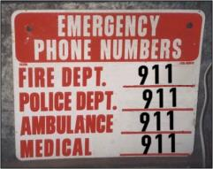
Emergency & First-Response
Preparation Include:
Posted emergency action plan
Employee training on emergency action plans
Appropriate placement of telephones & radios
Posting of emergency phone numbers by each phone
Address and directions for finding all worksites
Pre-determined meeting place following an incident
Notes:
Instructor Notes:
Every employer involved in operating potentially hazardous equipment or facilities such as grain storage and handling operations or other types of agricultural confined spaces should have given consideration to preparing for the potential for emergencies. In fact, at non-exempt grain storage and handling facilities this measure is required under the OSHA rules. Preparation is a key component of emergency management. Trying to locate a phone number or identifying who should be called during an emergency can result in wasted time and greater potential for a minor incident becoming a much more serious one.
Key preparation measures should include:
Posting of an approved emergency action plan for the most probable types of emergencies.
Employee training on the site’s emergency action plan. (This may be required annually.)
Appropriate placement of telephones or other communication devices such as radios or cell phones. (Remember, some devices such as cell phones may not work inside of an agricultural confined space.)
Posting of emergency phone numbers by each phone or having emergency phone numbers preprogrammed into personal cell phones. (Remember, 911 may not be available in rural communities.)
Having the address and directions to each worksite posted by each phone. In many cases, callers will forget how to get to a specific site or give an incorrect address due to the confusion caused by an emergency situation.
Identification of a pre-determined meeting place where all employees can meet following an emergency situation. Young and beginning workers have been known to leave the site after an incident resulting in them being listed as missing. This can lead to unnecessary search and rescue efforts.
Used with permission from Purdue University, Susan Harwood grant SH23575SH3

Slide 23
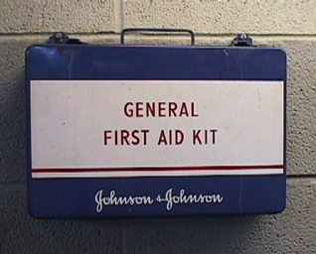
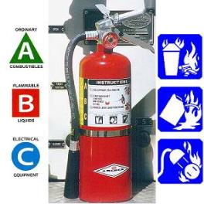
Emergency & First-Response
Preparation Should Also Include:
Access to first aid kit
Appropriate placement of properly rated fire extinguishers
Training of staff in first aid and emergency specific types of response
Access to specialized emergency response protective equipment
Notes:
Instructor Notes:
Emergency and first-response preparation should include other measures designed to mitigate or reduce the impact of an emergency situation. Most of these steps are low cost and take little time to implement. Young and beginning workers should become familiar with all the emergency preparation measures that have been taken in the worksite. Encourage participants to speak up and ask for information and training on what has been done to enhance emergency preparedness. Other measures that most workplaces will have in place include:
Access to first-aid kit
Appropriate placement of properly rated fire extinguishers
Training of staff in first-aid and specific types of emergency response
Access to specialized emergency response protective equipment for the hazards found in the workplace
A call is made to local emergency response services who are better trained or equipped to handle the emergency. Young and beginning workers need to know how they fit in and be made aware of their responsibilities in the event of an emergency.
Used with permission from Purdue University, Susan Harwood grant SH23575SH3

Slide 24
OSHA Section 5(a)(1),
The General Duty Clause of the Act, employers must provide their employees with a workplace free from recognized hazards likely to cause death or serious physical harm.
Notes:
If OSHA found a hazard in agriculture, they would issue a 5a1-general duty clause violation.

Slide 25
Small Farm Exemption
The Appropriations Act exempts small farming operations from enforcement of all rules, regulations, standards or orders under the Occupational Safety and Health Act. A farming operation is exempt from all OSHA activities if it:
  Employs 10 or fewer employees currently and at all times during the last 12 months; and
  Has not had an active temporary labor camp during the preceding 12 months.
  Immediate family members are considered exempt
Source: OSHA Instruction CPL 02-00-051
Must still provide a safe work place

Slide 26
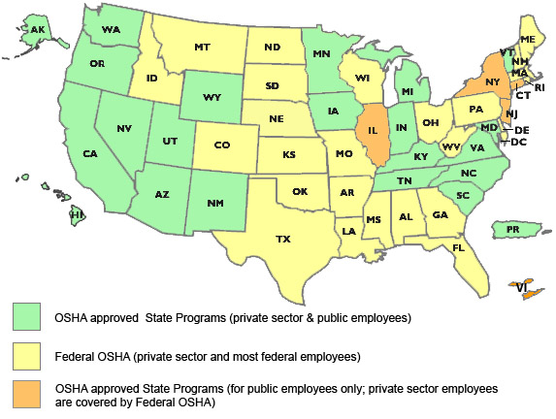
State to State
Important to check with your state OSHA since
There are 22 states with state plans and another 5 states which cover state and local government workers only.
OSHA Site (https://www.osha.gov/dcsp/osp/index.html)
Notes:
‘Twenty-six states, Puerto Rico, and the Virgin Islands have OSHA-approved State Plans. Twenty-two State Plans (21 states and one U.S. territory) cover both private and state and local government workplaces. The remaining six State Plans (five states and one U.S. territory) cover state and local government workers only. ‘

Slide 27
OSHA and Agriculture
OSHA requires the use of personal protective equipment (PPE) to reduce employee exposure to hazards when engineering and administrative controls are not feasible or effective in reducing these exposures to acceptable levels. Employers are required to determine if PPE should be used to protect their workers.
Source: http://www.osha.gov/SLTC/personalprotectiveequipment/

Slide 28
Employee Rights and Responsibilities
You have the right to:
  A safe and healthful workplace
  Know about hazardous chemicals
  Information about injuries and illnesses in your workplace
  Complain or request hazard correction from employer
Notes:
28

Slide 29
Employee Rights and Responsibilities (continued)
You have the right to:
  Training
  Access to hazard exposure and medical records
  File a complaint with OSHA
  Participate in an OSHA inspection
  Be free from retaliation for exercising safety and health rights
Notes:
29

Slide 30
Employee Rights and Responsibilities (Slide 3)
OSHA website: OSHA website and OSHA offices: Call or Write (800-321-OSHA)
Compliance Assistance Specialists in the area offices
National Institute for Occupational Safety and Health (NIOSH) – OSHA’s sister agency
OSHA Training Institute Education Centers
Doctors, nurses, other health care providers
Public libraries
Other local, community-based resources
Notes:
30

Slide 31

OSHA Whistleblower factsheet
Whistleblower Fact Sheet
https://www.osha.gov/OshDoc/data_General_Facts/whistleblower_rights.pdf
Notes:
Review Employee Rights – OSHA Publication Fact Sheet (MAP 21)

Slide 32

Whistleblower Protection Program
Notes:
With in OSHA is the whistle blower program - https://www.whistleblowers.gov/index.html
Website resources
22 statutes

Slide 33


Disclaimers
This material was produced under a grant (SH-27642-SH6) from the Occupational Safety and Health Administration, U.S. Department of Labor. It does not necessarily reflect the views or policies of the U.S. Department of Labor, nor does the mention of trade names, commercial products, or organization, imply endorsement by the U.S. Government.
Notes:
Material possible from
US Dept of Health and Human Services
OSHA

Slide 34



The National Education Center for Agricultural Safety (NECAS)
8342 NICC Drive
Peosta Iowa 52068
Phone: 888-844-6322
Fax: 563-557-0353
Email:neenand@nicc.edu
NECAS Site www.necasag.org
www.facebook.com/necasag
“an agricultural safety and health partnership between the
National Safety Council and Northeast Iowa Community College”
NICC
Notes:
NECAS is the National Education Center for Agricultural Safety and is a partnership between Northeast Iowa Community College (NICC) and the National Safety Council and is a hands on Ag safety training site.

