Slide 1

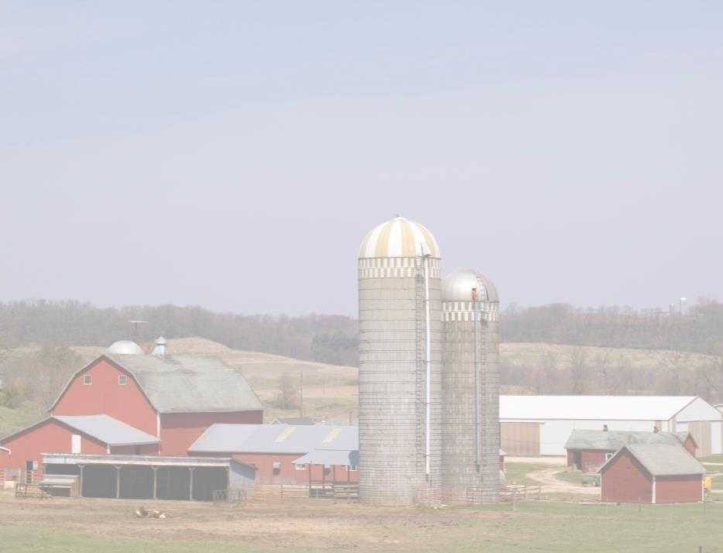
Chainsaw Safety for Youth
This material was produced under a grant (SH-29625-SH6) from the Occupational Safety and Health Administration, U.S. Department of Labor. It does not necessarily reflect the views or policies of the U.S. Department of Labor, nor does the mention of trade names, commercial products, or organization imply endorsement by the U.S. Government.

Slide 2
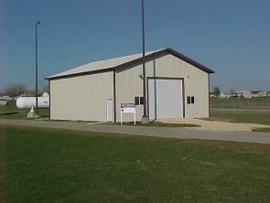
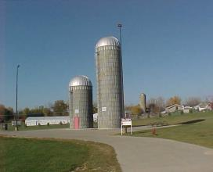
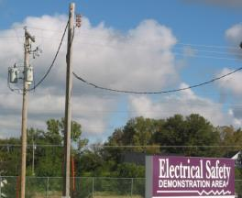
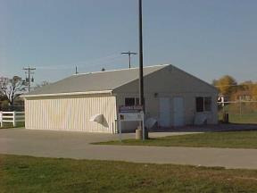
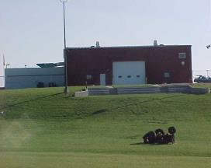
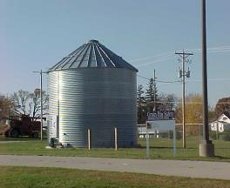
Hands-on Training Sites
Farm chemical site
Silo training props
Electrical Safety
Confinement building
Tractor rollover
Grain Bin prop
Notes:
Pictures from NECAS

Slide 3
Program Objectives
At the conclusion of this presentation, participants will:
Be able to identify hazards associated with Chainsaw use in Agriculture
Know where to look for OSHA references and resources related to Chainsaw use in Agriculture
To safely perform maintenance on your Chainsaw

Slide 4
Before Using the Chainsaw
Check Controls
Check Chain Tension
Fuel the saw

Slide 5
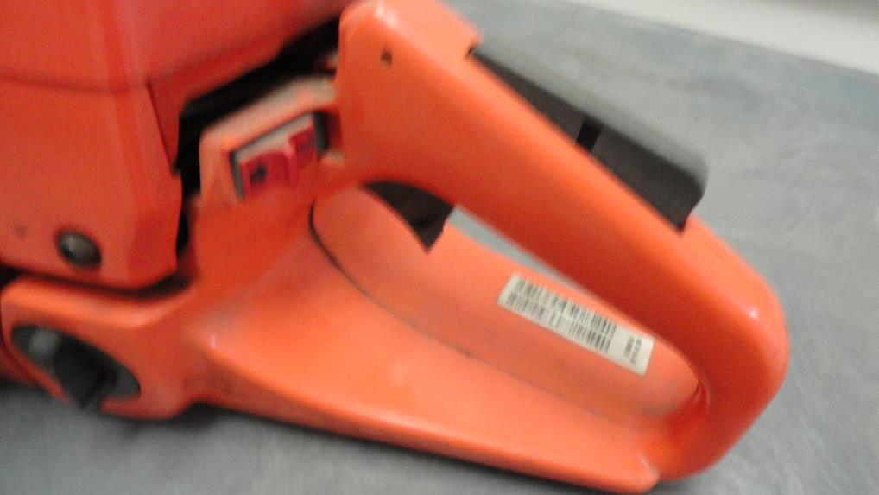
Check the Controls
Throttle trigger interlock
Stop Switch
Notes:
Photo courtesy of NECAS
Always check your controls before starting your chainsaw. Although each manufacturer is different you will need to turn the saw operational switch to the on position, press the safety switch located on the top of the handle and pull up on the throttle switch before pulling the cord to start the saw

Slide 6
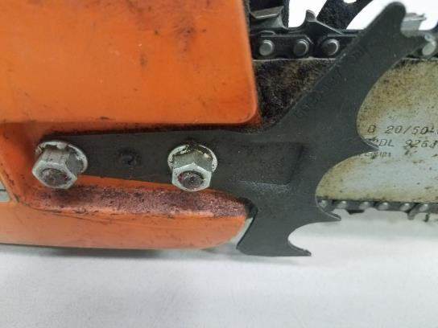
Check the Chain Tension
Check chain tension after every hour of use
New chains stretch and need to be checked after 20 minutes
Adjusting screws
Notes:
Before operating, check the chain tension. Recheck it after every hour or so of use, and adjust it if necessary. New chains stretch and need to be checked after 20 minutes of use. Loose chains can fly off the bar, causing serious injury.
To make adjustments, loosen the bar nuts that hold the bar. Then lift the bar while tightening the adjusting screw until the chain is snug against the bar. The tension is correct when you can’t lift the chain drivers free of the bar groove but you can still drag the chain easily around the bar with a gloved hand. Retighten the bar nuts. Run the saw before using it to cut.

Slide 7
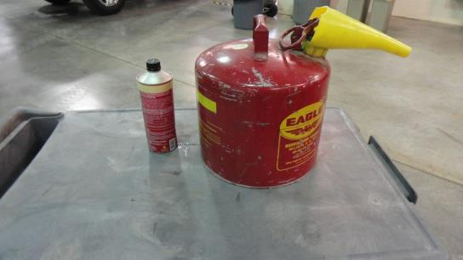
Fueling the Chainsaw
Fuel saw at least 10 feet away from sources of ignition
The fuel container must:
Be metal or plastic
Must not exceed 5 gallon capacity
Must be approved by Nationally Recognized Testing Laboratory
Notes:
Source: OSHA Fact sheet
Can be approved by Underwriters Laboratory, Factory Mutual (FM), the Department of Transportation (DOT), or other Nationally Recognized Testing Laboratory.
Only fuel saw when the engine is cool, vapors from adding fuel can ignite with a hot engine.

Slide 8
While Running the Saw
Shut off or release throttle before retreating
Shut off or engage chain break if moving more than 50 feet
Clear away dirt, debris, small tree limbs and rocks from the saw's chain path. Look for nails, spikes or other metal in the tree before cutting.
Shut off the saw or engage its chain brake when carrying the saw on rough or uneven terrain.
Never cut alone-always have a partner
Never drop start the chainsaw, always start it on the ground
Notes:
Source: OSHA Fact Sheet

Slide 9
While Running the Saw (Part 2)
Proper personal protective equipment must be worn when operating the saw, which includes hand, foot, leg, eye, face, hearing and head protection.
Do not wear loose-fitting clothing.
Be careful that the trunk or tree limbs will not bind against the saw.
Watch for branches under tension, they may spring out when cut.
Keep your hands on the saw's handles, and maintain secure footing while operating the saw.
Do not cut items directly above head
Notes:
Source: https://www.osha.gov/Publications/3269-10N-05-english-06-27-2007.html

Slide 10
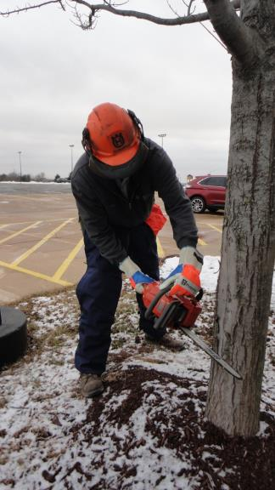
Personal Protective Equipment
Notes:
Photo courtesy of NECAS
Wear all Personnel Protective equipment when operating a chainsaw every time you operate the saw.
Leg protection should be made of a cut-retardant material designed to reduce the risk or severity of injury to the body parts covered by the pads in the event of contact with the rotating saw chain of a gasoline-powered chainsaw

Slide 11

Head/Eye/Face/Hearing Protection
Notes:
Picture Courtesy of NECAS
Our person is wearing a protective helmet with hearing protection and face protection built in, he is also wearing protective glasses with side shields

Slide 12
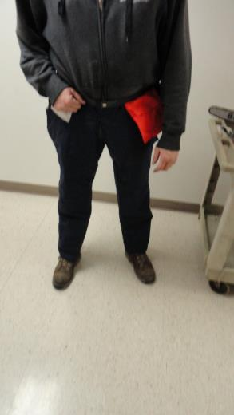
Leg Protection
Leg protection should be made of a cut-retardant material designed to reduce the risk or severity of injury to the body parts covered by the pads in the event of contact with the rotating saw chain of a gasoline-powered chainsaw
Notes:
Photo courtesy of NECAS
Many manufactures make leg protection that is cut resistant, injuries occur when a running chain saw blade comes in contact with the skin on the legs

Slide 13
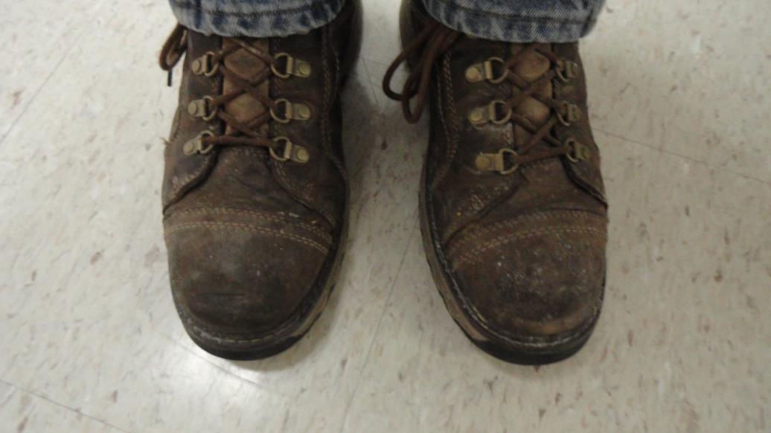
Foot Protection
Notes:
Photo Courtesy of NECAS Source: https://www.osha.gov/SLTC/etools/logging/manual/logger/foot_protection.html
Employers shall assure that each employee wear heavy duty logging boots that are waterproof or water repellant, and cover and provide support to the ankle. If the employee uses a chain saw, the footwear must be constructed with cut-resistant material that will protect against contact with a running chain saw. Calk soled boots are acceptable when they are required for the employee's job. [29 CFR 1910.266(d)(1)(v)] Underwriters Laboratories (UL) currently tests and labels foot protection which meets minimum cut resistance requirements. (Reference ASTM F1818, Standard Specification for Foot Protection for Chain Saw Users.)

Slide 14
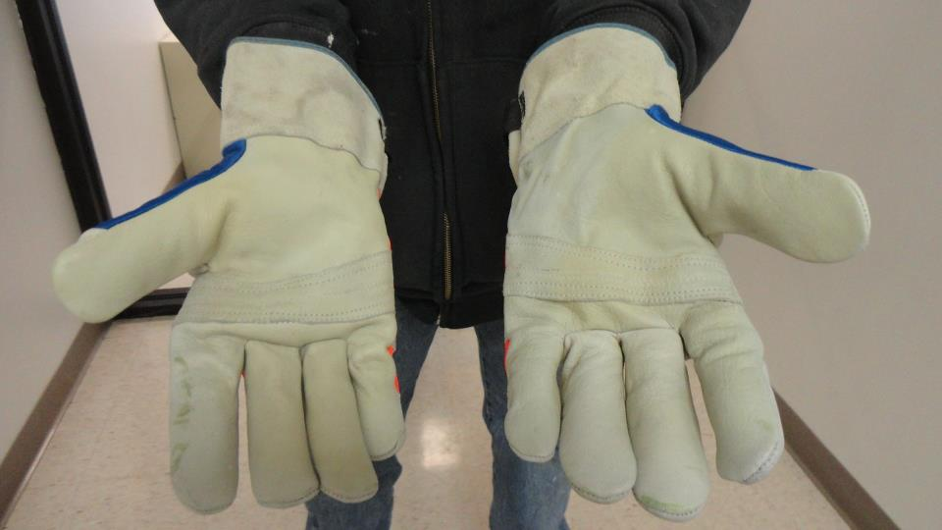
Hand Protection
Notes:
Photo Courtesy of NECAS
Gloves should be cut resistant with vibration protection.

Slide 15
Training
Blood borne Pathogens
CPR and First Aid
Specific work procedures, practices and requirements of the work site
How to safely use, operate, and maintain tools
How to safely perform assigned work task
Notes:
Source: OSHA fact sheet
Employers involved in tree removal/logging are required to assure that their employees are able to safely perform their assigned task. When loggers are trained to work safely they should be able to anticipate and avoid injury from the job related hazards they may encounter

Slide 16
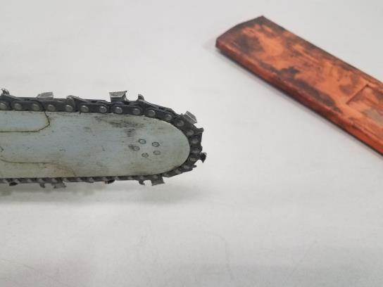
Kickbacks
Be cautious of saw kick-back. To avoid kick-back, do not saw with the tip. If equipped, keep tip guard in place.
Notes:
Photo Courtesy of NECAS
Source: https://www.osha.gov/Publications/3269-10N-05-english-06-27-2007.html

Slide 17

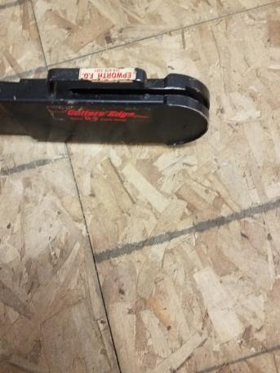
Tip Guard
Notes:
Photo on left courtesy of Oregon parts
Photo on right courtesy of NECAS:
Be cautious of saw kick-back. To avoid kick-back, do not saw with the tip. If equipped, keep tip guard in place. Follow kick-back prevention instructions to reduce risk of kick-back injury when cutting without kick guard.
Second photo shows a device that protects the operator from the chain and allows the depth of cut to be set so no structural members are cut. Tool-less design allows fast and easy adjustments and removal in seconds, even with gloves on.

Slide 18
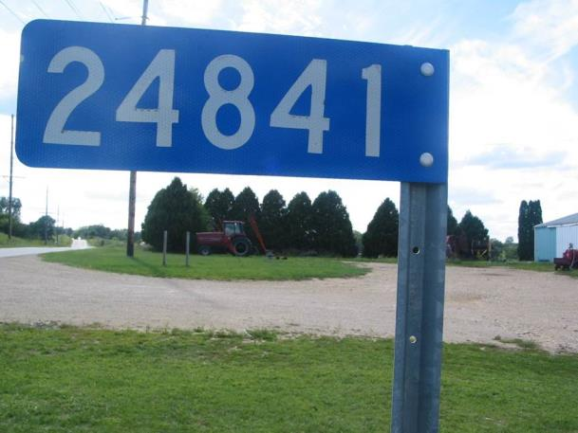
Know your Location
Notes:
A lot of farms today not only include the home farm but rental properties or purchased farms not located adjunct to the home farm. It is important to know the physical address and 911 address of the location. It is recommended that you write down each farm, its 911 address, physical address, and who owned it before. This information should be carried in every moving vehicle that goes from farm to farm. The GPS on your phone can track you in an emergency but that takes time and in an emergency that time could be essential.

Slide 19

Calling 911
Name:
Address or 911 number
Exact nature of the emergency
Do not hang up
Notes:
Instructor Notes:
When a call for emergency services is made, usually to 911, the dispatcher needs several important pieces of information to ensure that assistance is provided in a timely manner. It is extremely important that the caller stay on the line until the dispatcher is adequately informed. In some cases, 911 calls are made and the caller hangs up before an address is provided or the nature of the emergency is explained. In some communities, the 911 dispatcher knows the address and the callers identification. However, the caller’s home address may not be the site where the assistance is needed.
In most cases the 911 dispatcher will ask the following:
Name, first and last, of the call
Address where the incident has occurred, not necessarily the address of the caller
The exact nature of the emergency including the known number of victims and the nature of their injuries if known
It is important for the caller to know their location. So many farmers are renting and buying farms away from the home farm. It is important to write down the name , address, 911 address of each farm they own or rent. Copy this and put it in every vehicle that will go from farm to farm.
Remember, remind the participants to not hang up on the 911 dispatcher until the dispatcher has gotten all the information they need.
Photo courtesy of Dubuque County Iowa dispatch center. Used with permission.

Slide 20
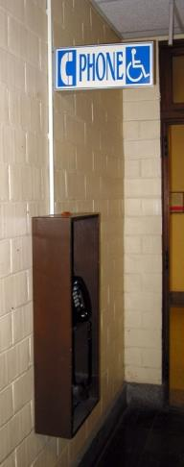
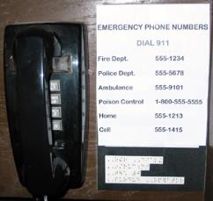

Emergency & First-Response Preparation Include:
Posted emergency action plan
Employee training on emergency action plans
Appropriate placement of telephones & radios
Posting of emergency phone numbers by each phone
Address and directions for finding all worksites
Pre-determined meeting place following an incident
Notes:
Instructor Notes:
Every employer involved in operating potentially hazardous equipment or facilities such as grain storage and handling operations or other types of agricultural confined spaces should have given consideration to preparing for the potential for emergencies. In fact, at non-exempt grain storage and handling facilities this measure is required under the OSHA rules. Preparation is a key component of emergency management. Trying to locate a phone number or identifying who should be called during an emergency can result in wasted time and greater potential for a minor incident becoming a much more serious one.
Key preparation measures should include:
Posting of an approved emergency action plan for the most probable types of emergencies.
Employee training on the site’s emergency action plan. (This may be required annually.)
Appropriate placement of telephones or other communication devices such as radios or cell phones. (Remember, some devices such as cell phones may not work inside of an agricultural confined space.)
Posting of emergency phone numbers by each phone or having emergency phone numbers preprogrammed into personal cell phones. (Remember, 911 may not be available in rural communities.)
Having the address and directions to each worksite posted by each phone. In many cases, callers will forget how to get to a specific site or give an incorrect address due to the confusion caused by an emergency situation.
Identification of a pre-determined meeting place where all employees can meet following an emergency situation. Young and beginning workers have been known to leave the site after an incident resulting in them being listed as missing. This can lead to unnecessary search and rescue efforts.
Used with permission from Purdue University, Susan Harwood grant SH23575SH3

Slide 21
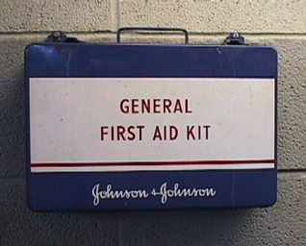
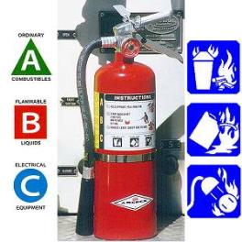
Emergency & First-Response Preparation Should Also Include:
Access to first aid kit
Appropriate placement of properly rated fire extinguishers
Training of staff in first aid and emergency specific types of response
Access to specialized emergency response protective equipment
Notes:
Instructor Notes:
Emergency and first-response preparation should include other measures designed to mitigate or reduce the impact of an emergency situation. Most of these steps are low cost and take little time to implement. Young and beginning workers should become familiar with all the emergency preparation measures that have been taken in the worksite. Encourage participants to speak up and ask for information and training on what has been done to enhance emergency preparedness. Other measures that most workplaces will have in place include:
Access to first-aid kit
Appropriate placement of properly rated fire extinguishers
Training of staff in first-aid and specific types of emergency response
Access to specialized emergency response protective equipment for the hazards found in the workplace
A call is made to local emergency response services who are better trained or equipped to handle the emergency. Young and beginning workers need to know how they fit in and be made aware of their responsibilities in the event of an emergency.
Used with permission from Purdue University, Susan Harwood grant SH23575SH3

Slide 22
OSHA Section 5(a)(1),
The General Duty Clause of the Act, employers must provide their employees with a workplace free from recognized hazards likely to cause death or serious physical harm.
Notes:
If OSHA found a hazard in agriculture, they would issue a 5a1-general duty clause violation.

Slide 23
Small Farm Exemption
The Appropriations Act exempts small farming operations from enforcement of all rules, regulations, standards or orders under the Occupational Safety and Health Act. A farming operation is exempt from all OSHA activities if it:
Employs 10 or fewer employees currently and at all times during the last 12 months; and
Has not had an active temporary labor camp during the preceding 12 months.
Immediate family members are considered exempt
Source: OSHA Instruction CPL 02-00-051
Must still provide a safe work place

Slide 24
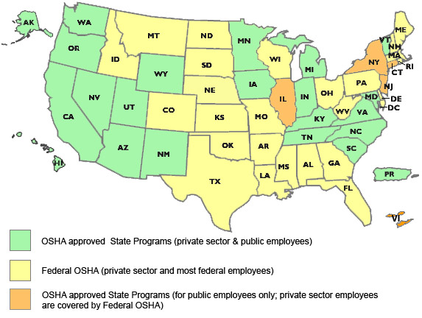
State to State
Important to check with your state OSHA since
There are 22 states with state plans and another 5 states which cover state and local government workers only.
OSHA Site (https://www.osha.gov/dcsp/osp/index.html)
Notes:
‘Twenty-six states, Puerto Rico, and the Virgin Islands have OSHA-approved State Plans. Twenty-two State Plans (21 states and one U.S. territory) cover both private and state and local government workplaces. The remaining six State Plans (five states and one U.S. territory) cover state and local government workers only. ‘

Slide 25
OSHA and Agriculture
OSHA requires the use of personal protective equipment (PPE) to reduce employee exposure to hazards when engineering and administrative controls are not feasible or effective in reducing these exposures to acceptable levels. Employers are required to determine if PPE should be used to protect their workers.
Source: http://www.osha.gov/SLTC/personalprotectiveequipment/

Slide 26
Employee Rights and Responsibilities
You have the right to:
A safe and healthful workplace
Know about hazardous chemicals
Information about injuries and illnesses in your workplace
Complain or request hazard correction from employer
Notes:
26

Slide 27
Employee Rights and Responsibilities (continued)
You have the right to:
Training
Access to hazard exposure and medical records
File a complaint with OSHA
Participate in an OSHA inspection
Be free from retaliation for exercising safety and health rights
Notes:
27

Slide 28
Employee Rights and Responsibilities (Slide 3)
OSHA website: www.osha.gov and OSHA offices: Call or Write (800-321-OSHA)
Compliance Assistance Specialists in the area offices
National Institute for Occupational Safety and Health (NIOSH) – OSHA’s sister agency
OSHA Training Institute Education Centers
Doctors, nurses, other health care providers
Public libraries
Other local, community-based resources
Notes:
28

Slide 29

OSHA Whistleblower factsheet
Whistleblower Fact Sheet
https://www.osha.gov/OshDoc/data_General_Facts/whistleblower_rights.pdf
Moving Ahead for Progress in the 21st Century Act (MAP-21)
Notes:
Review Employee Rights – OSHA Publication Fact Sheet (MAP 21)

Slide 30

Whistleblower Protection Program
Notes:
With in OSHA is the whistle blower program - https://www.whistleblowers.gov/index.html
Website resources
22 statutes

Slide 31


Disclaimers
This material was produced under a grant (SH-29625-SH6) from the Occupational Safety and Health Administration, U.S. Department of Labor. It does not necessarily reflect the views or policies of the U.S. Department of Labor, nor does the mention of trade names, commercial products, or organization, imply endorsement by the U.S. Government.
Notes:
Material possible from
US Dept of Health and Human Services
OSHA

Slide 32



The National Education Center for Agricultural Safety (NECAS)
“An agricultural safety and health partnership between the
National Safety Council and Northeast Iowa Community College”
8342 NICC Drive
Peosta Iowa 52068
Phone: 888-844-6322
Fax: 563-557-0353
Email:neenand@nicc.edu
NECAS Site www.necasag.org
www.facebook.com/necasag
NICC
Notes:
NECAS is the National Education Center for Agricultural Safety and is a partnership between Northeast Iowa Community College (NICC) and the National Safety Council and is a hands on Ag safety training site.

